Slide 1
Crisis Response: Ukraine Refugee Support
02268 Process-oriented and Event-driven Software Systems
Final Presentation
Group 2
Christian Hjelmslund | Daniel Grathwol | Laura Amenda | Luis Pieschel | Sebastian Specht

Slide 2
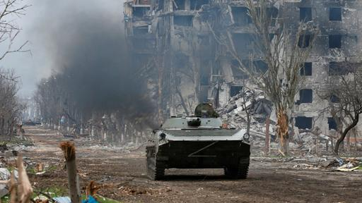
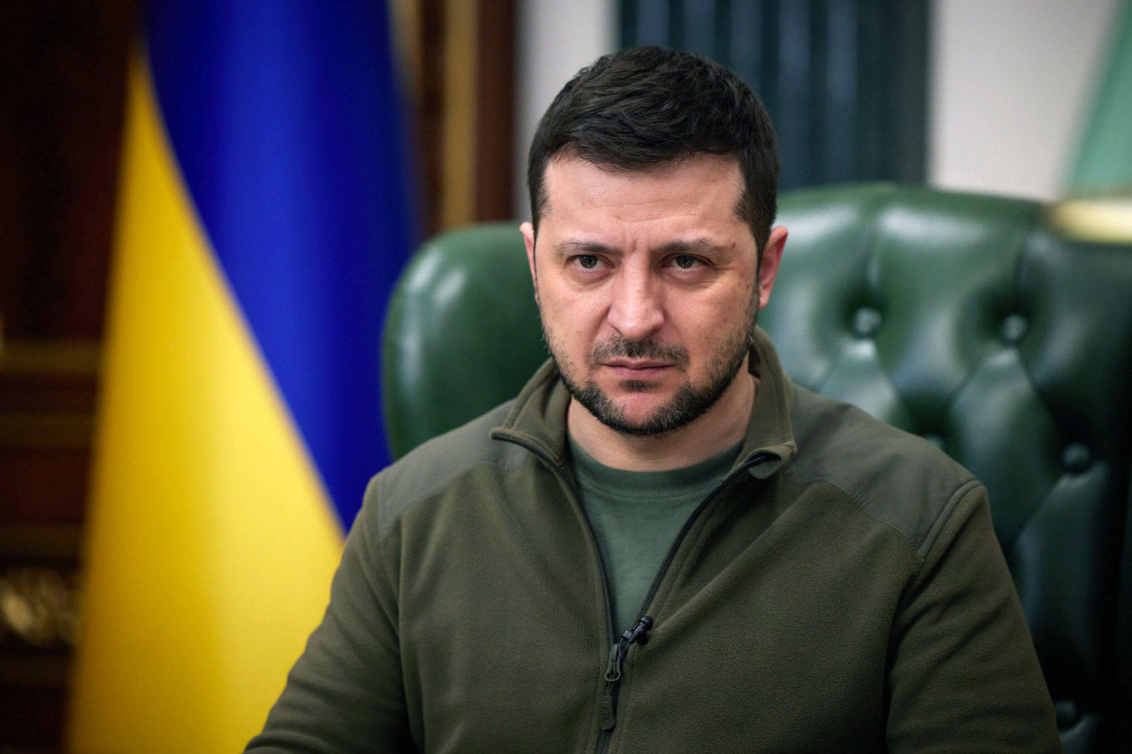
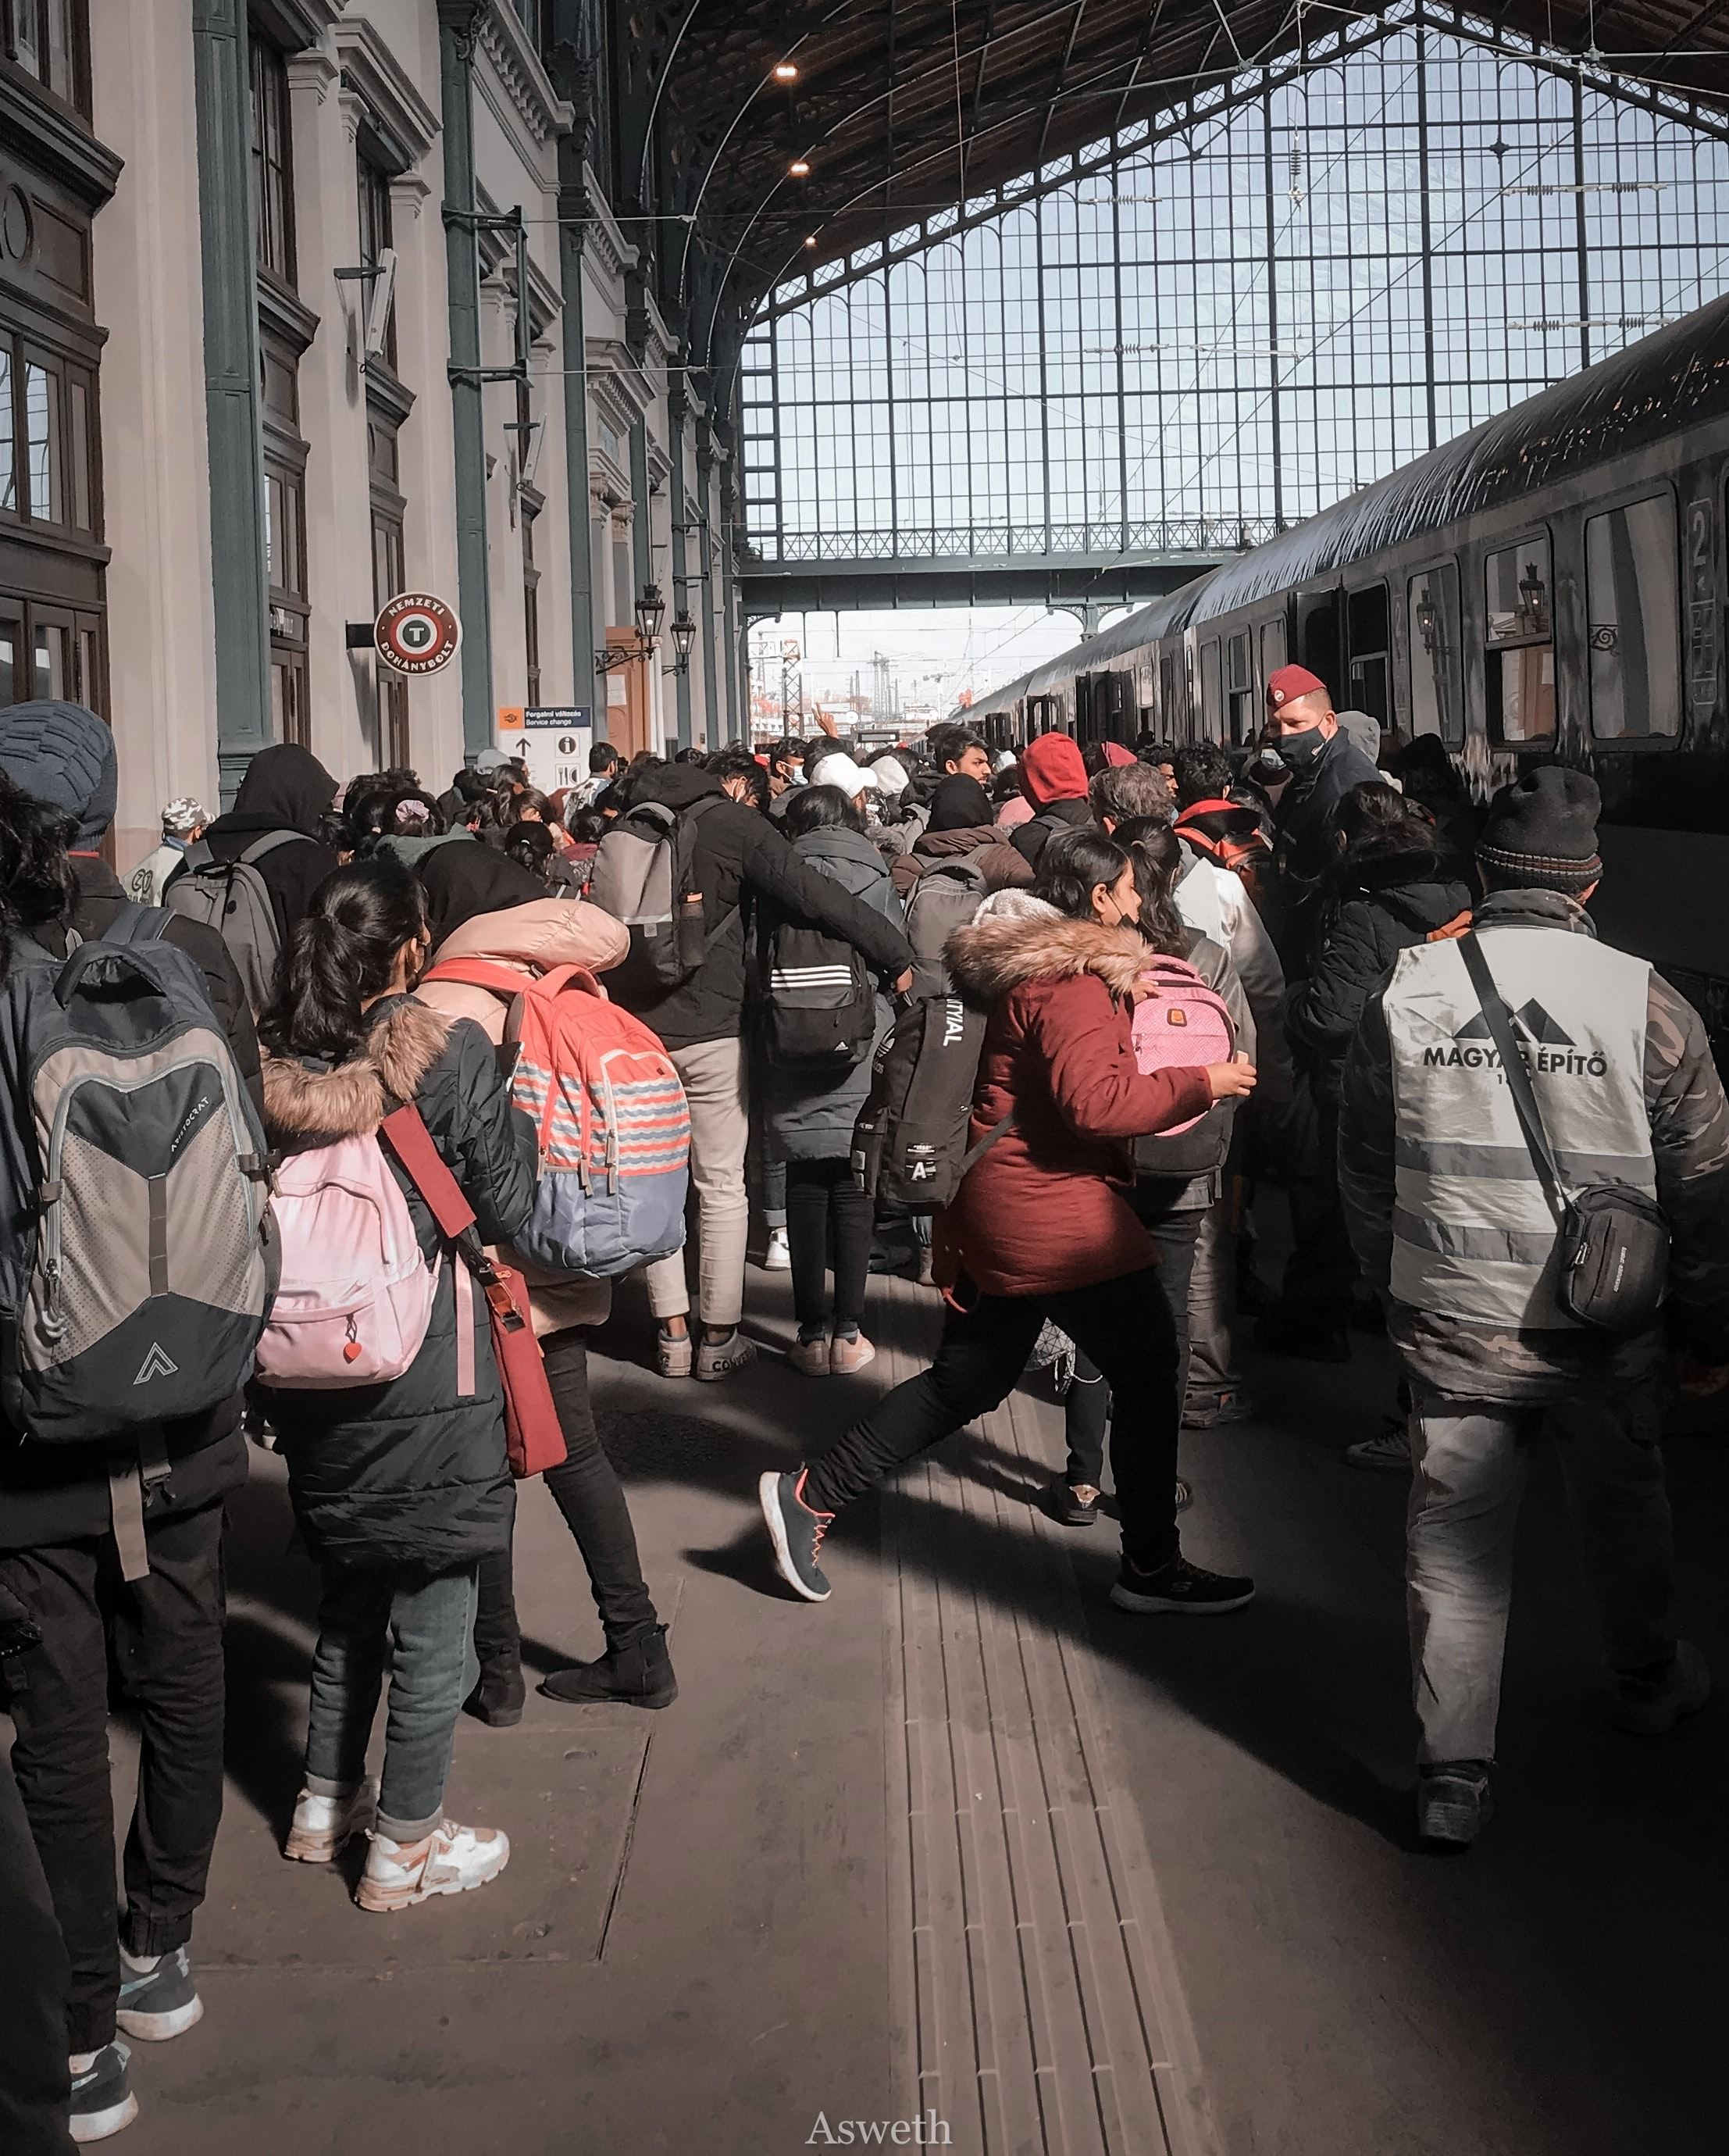
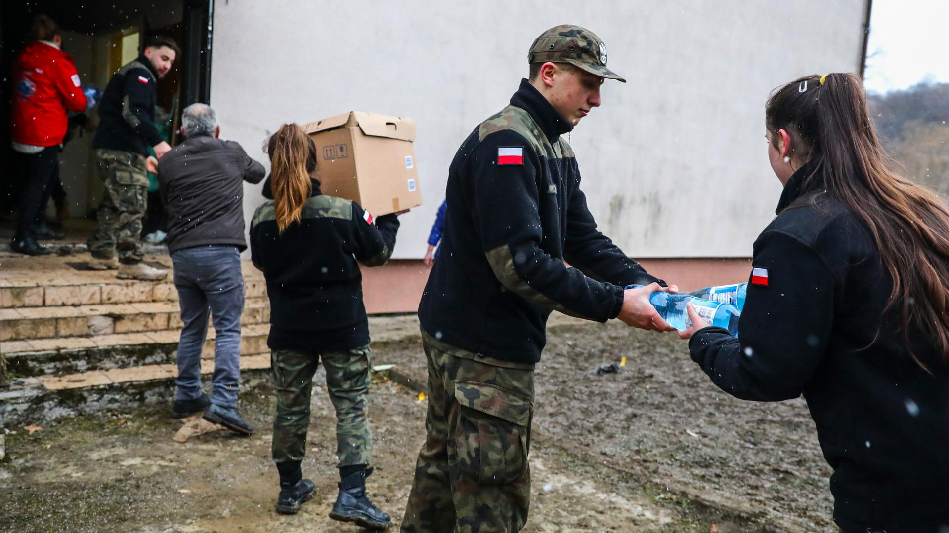
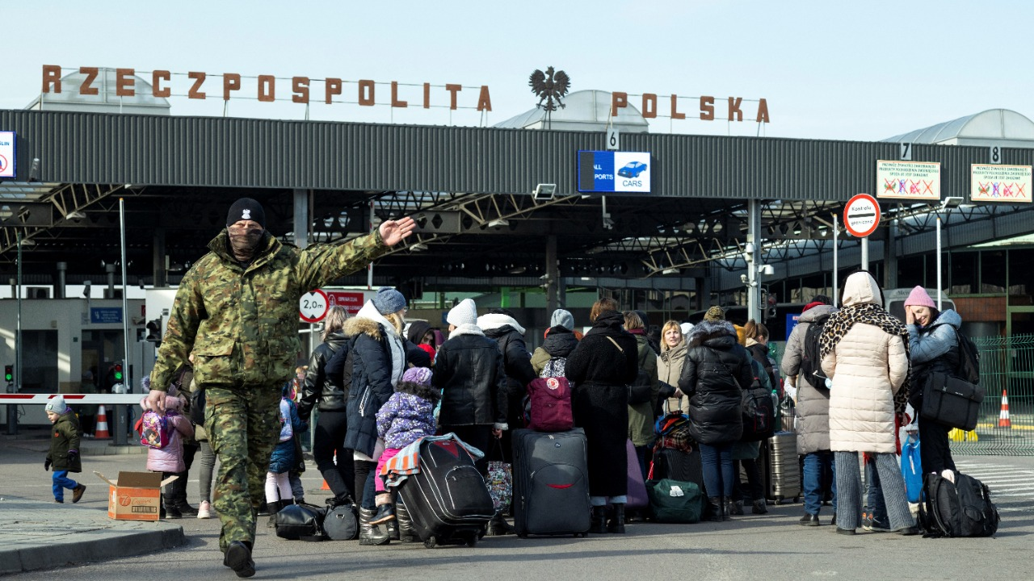
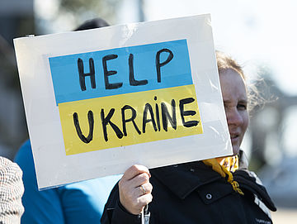
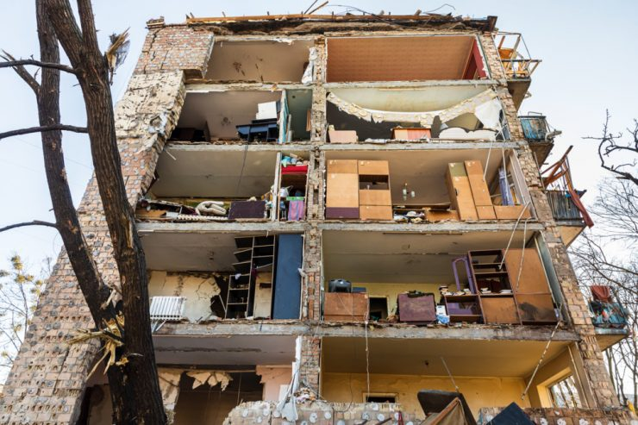
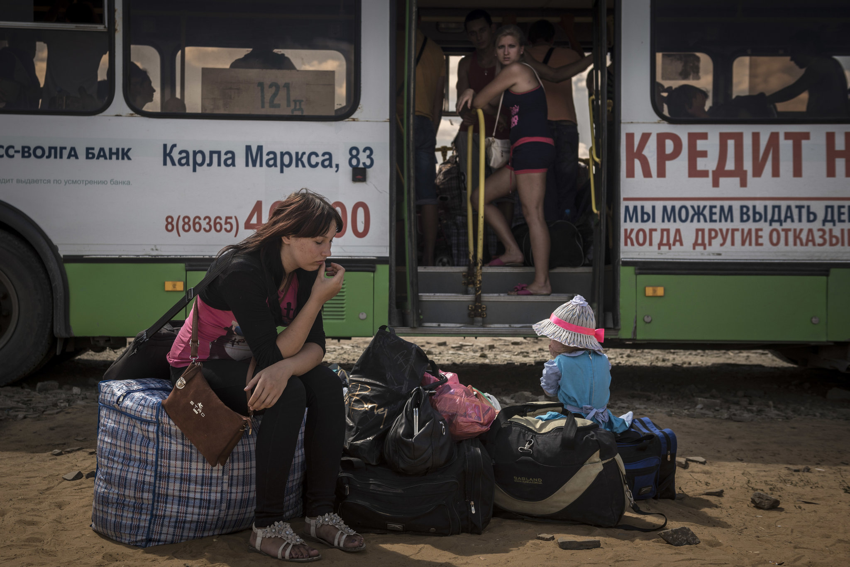
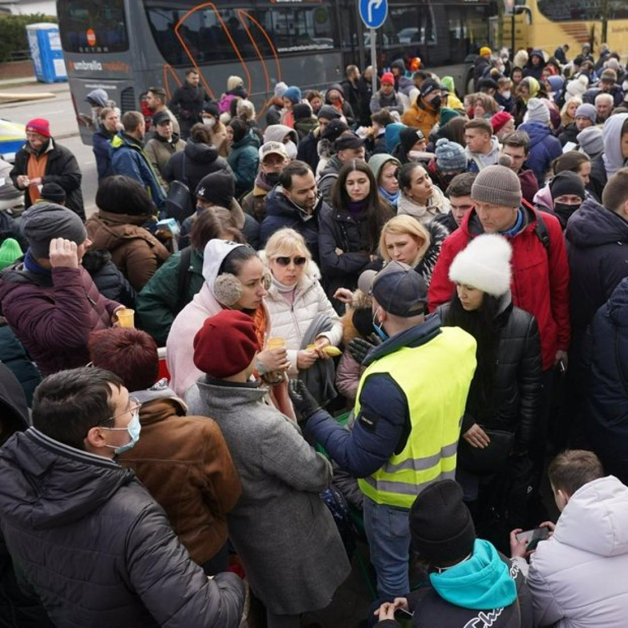
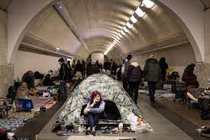
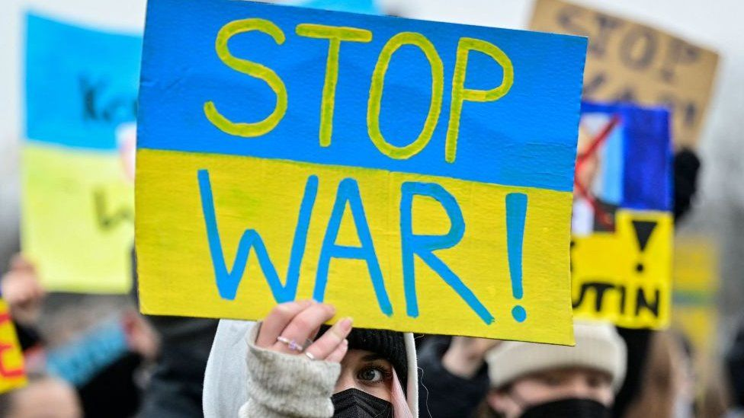

Slide 3
Agenda
Introduction and Domain Description
Business Model
Processes and Events
Implications and Limitations

Slide 4







Crisis Response: Ukraine Refugee Support 1. Introduction and Domain Description
Idea – Provide Support (Use Case: Ukraine-Russia conflict)
Mobile Application
Travel Support Service
Frontend
Visa Support Service​
External Sources
Job Application Support Service​
Backend

Slide 5
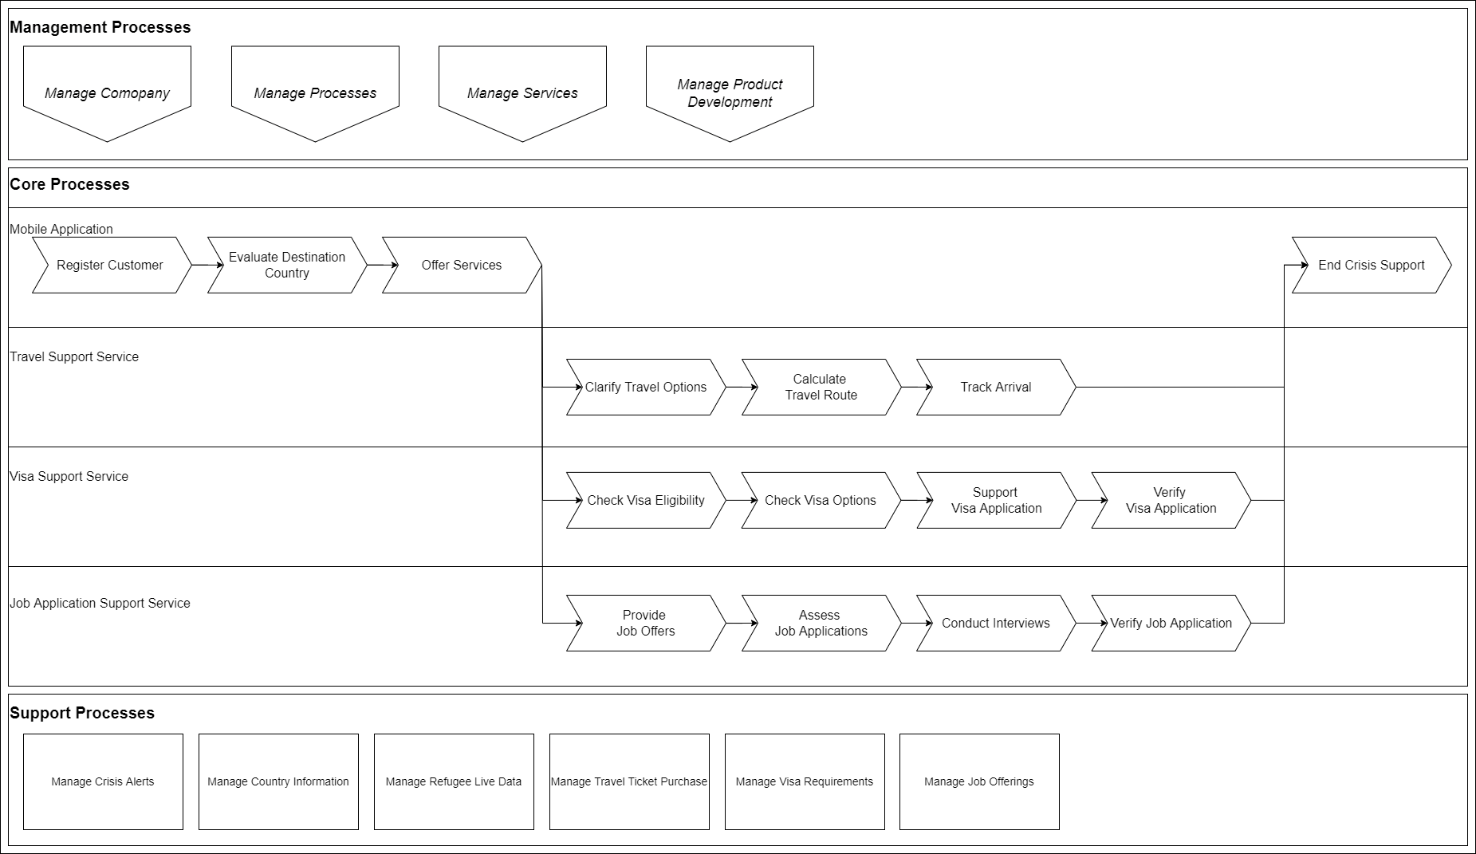
Crisis Response: Ukraine Refugee Support 2. Business Model – Process Landscape

Slide 6
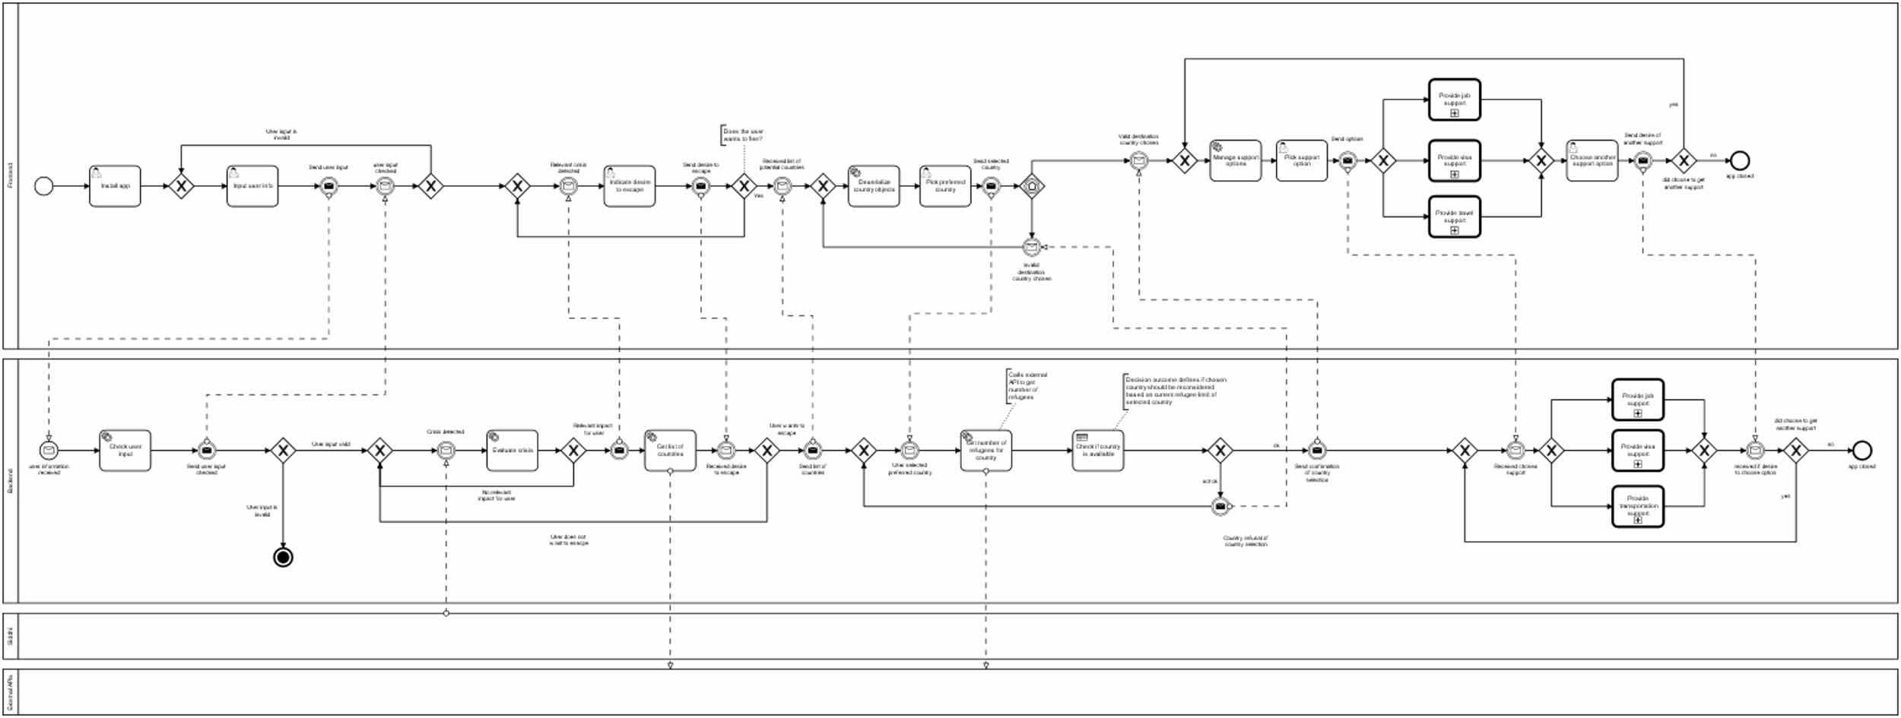
Crisis Response: Ukraine Refugee Support 2. Business Model – Main Process

Slide 7
Crisis Response: Ukraine Refugee Support 2. Business Model – Main Process

Slide 8

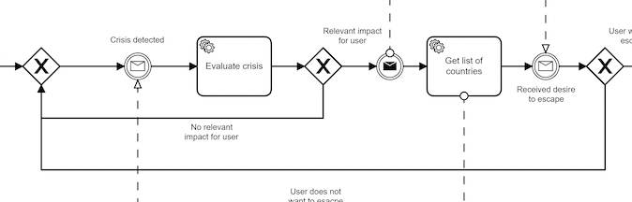

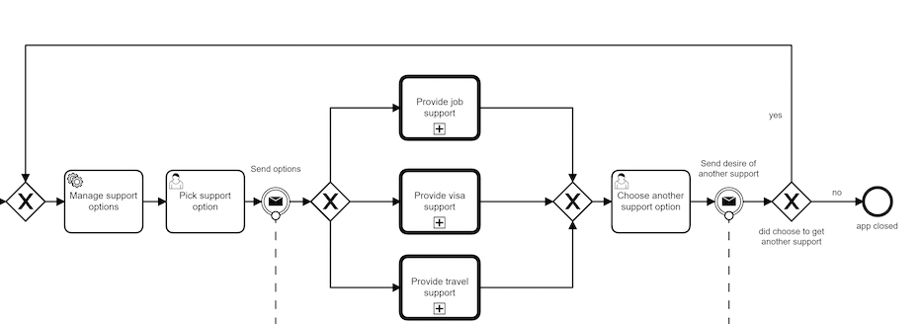
Crisis Response: Ukraine Refugee Support 2. Business Model – Main Process
Crisis Detection
Providing Support

Slide 9
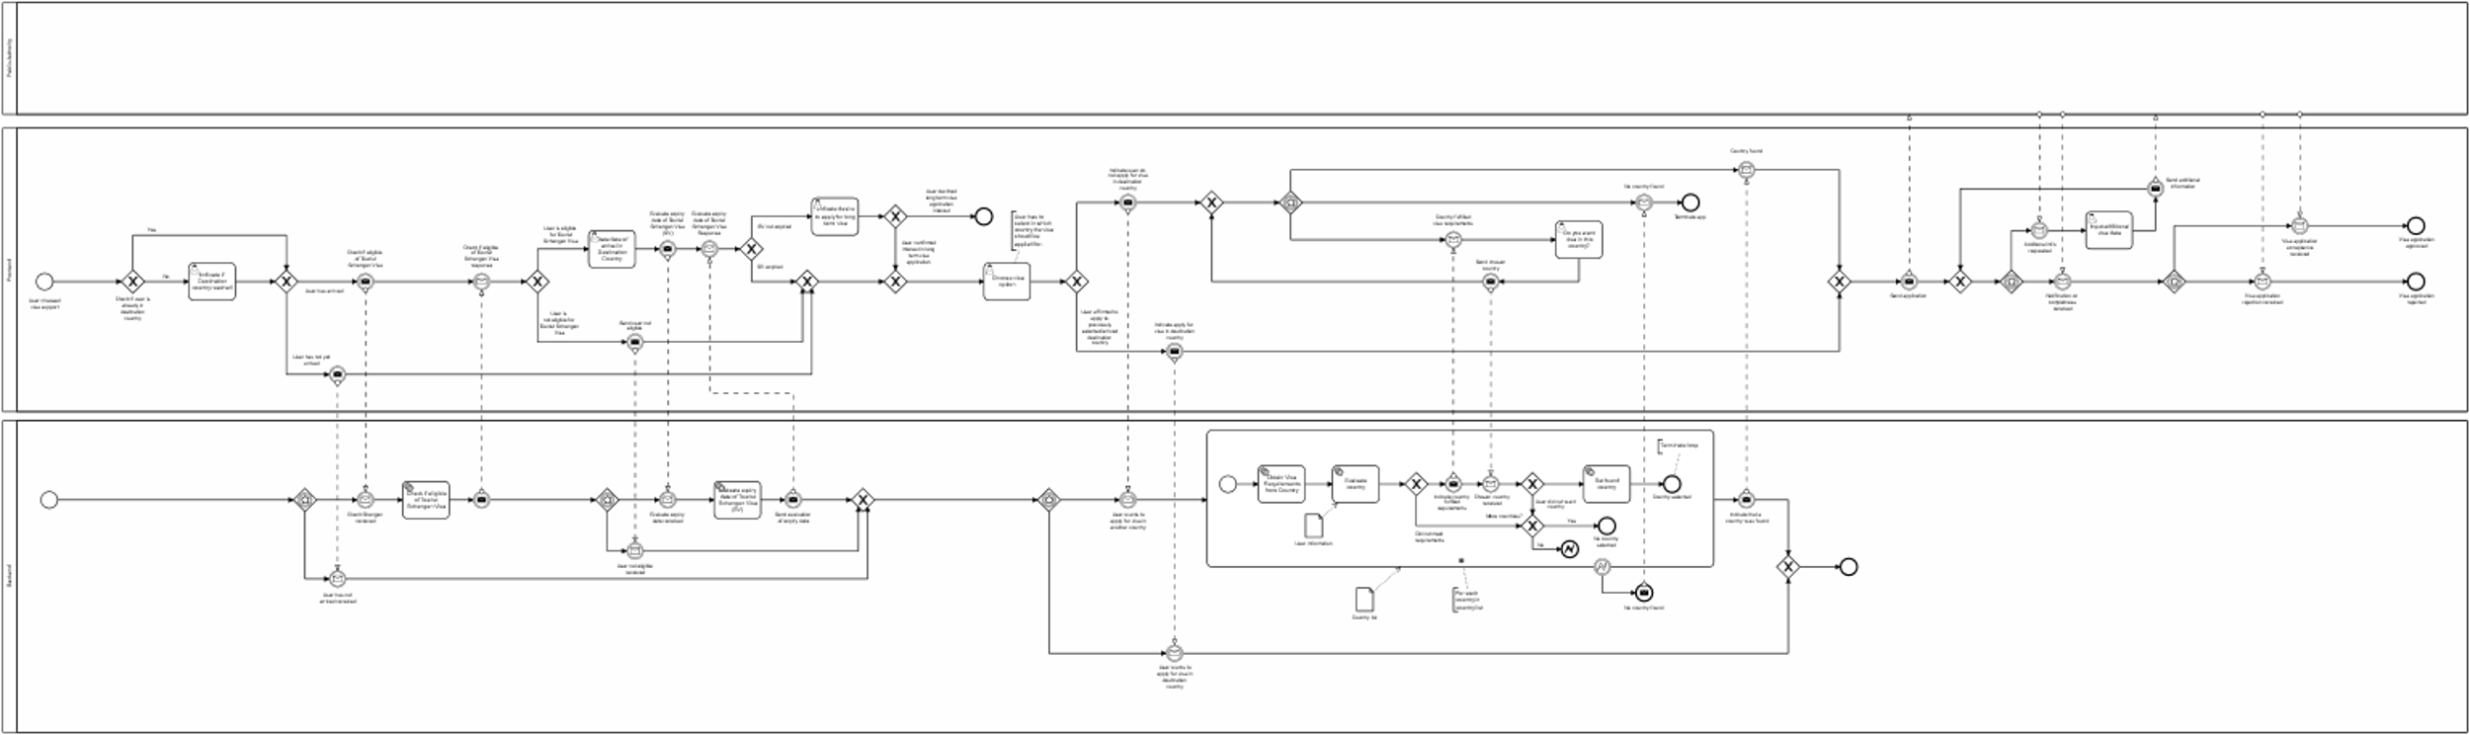
Crisis Response: Ukraine Refugee Support 2. Business Model – Visa Process

Slide 10

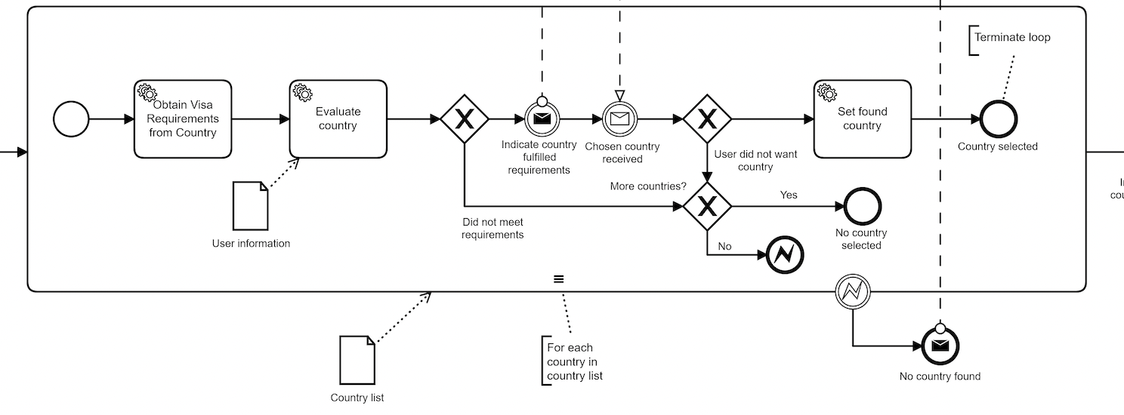
Crisis Response: Ukraine Refugee Support 2. Business Model – Visa Process
Multi Instance

Slide 11
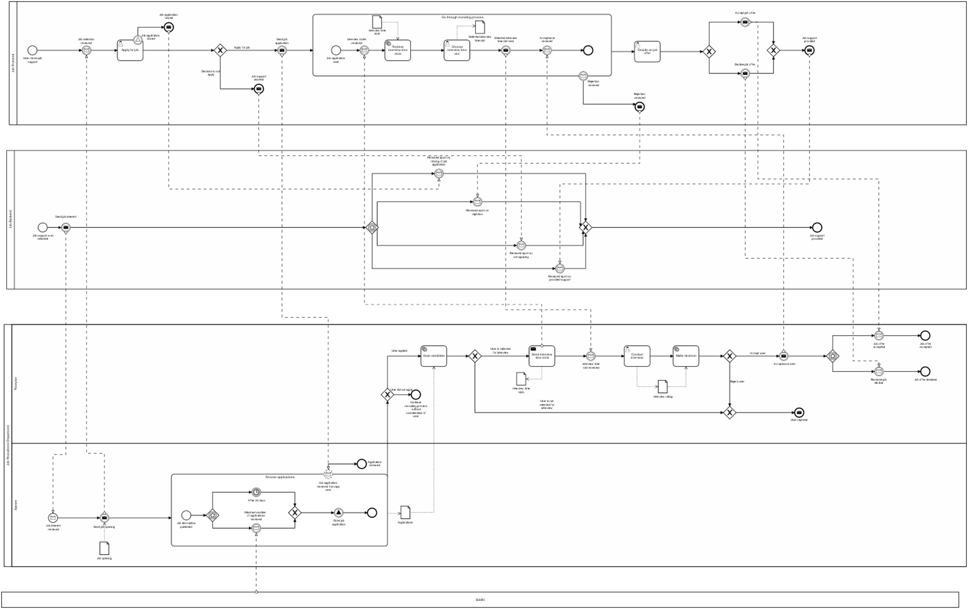
Crisis Response: Ukraine Refugee Support 2. Business Model – Job Process

Slide 12

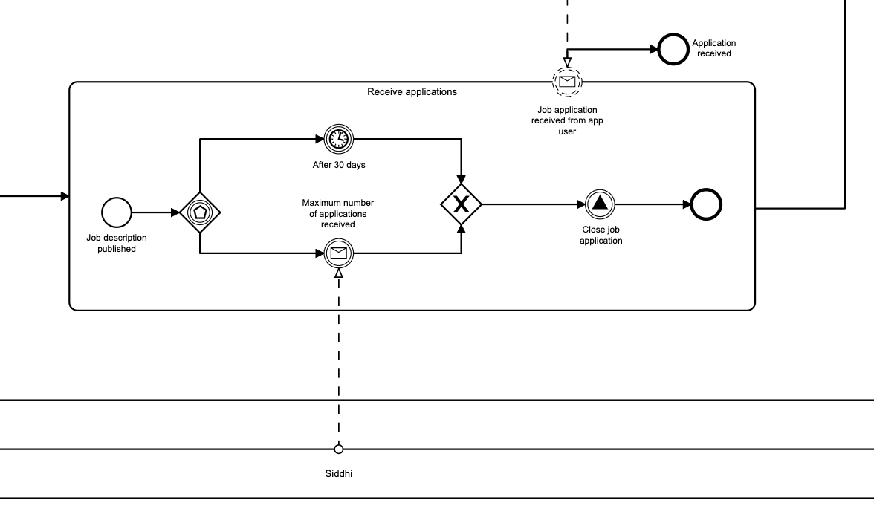
Crisis Response: Ukraine Refugee Support 2. Business Model – Job Process
Simulation of Application Window
ApB

Slide 13
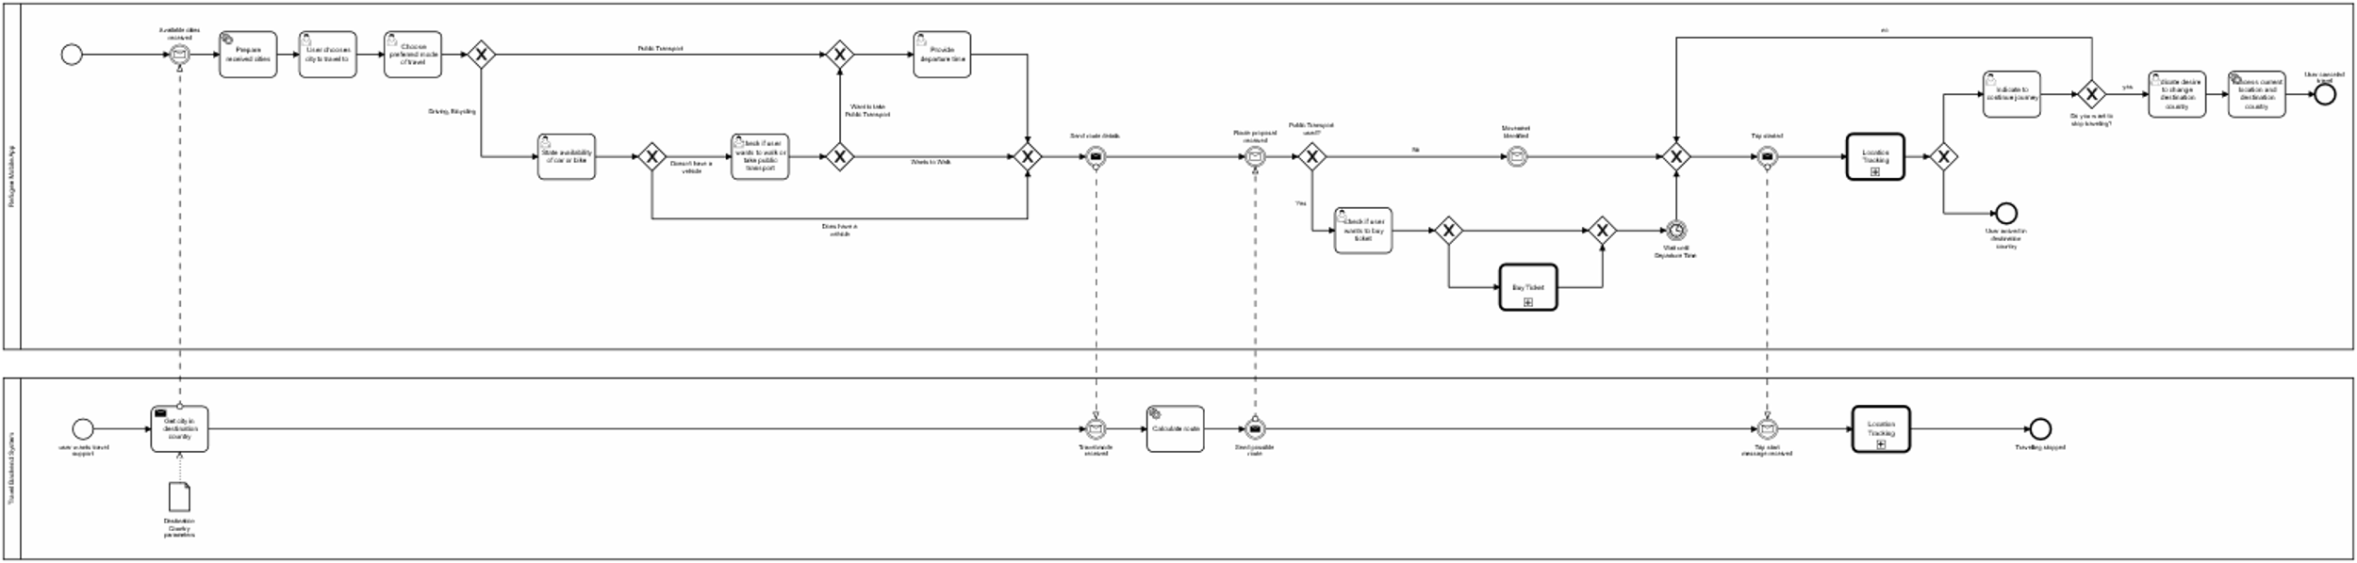
Crisis Response: Ukraine Refugee Support 2. Business Model – Travel Process

Slide 14

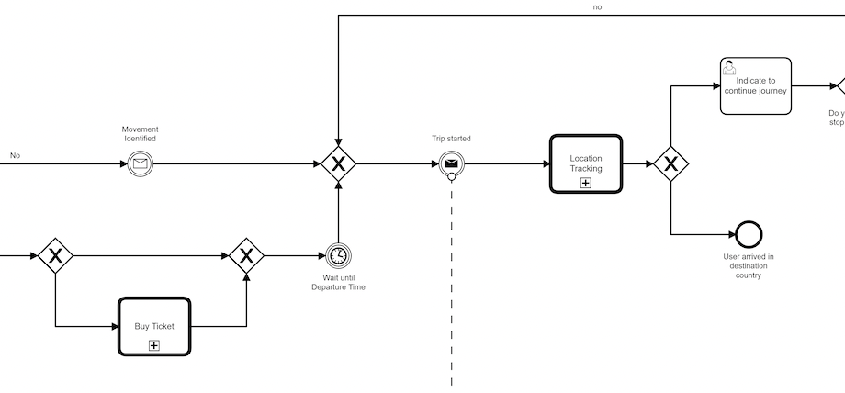
Crisis Response: Ukraine Refugee Support 2. Business Model – Travel Process
Location Tracking

Slide 15
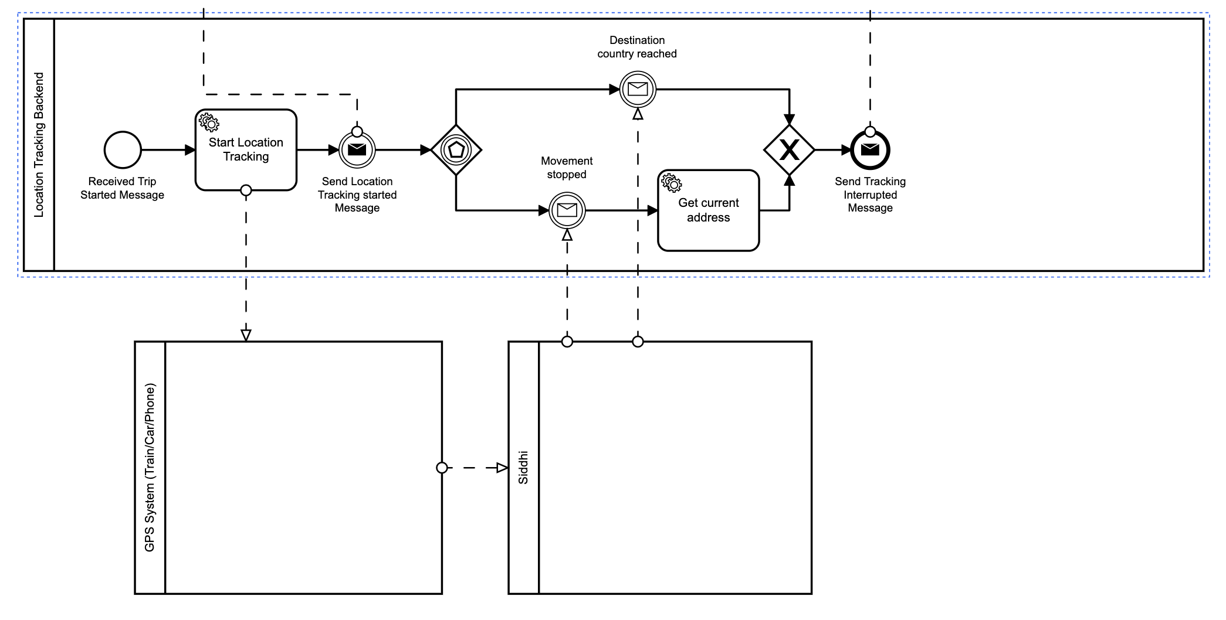
Crisis Response: Ukraine Refugee Support 2. Business Model – Travel Process
Location Tracking

Slide 16

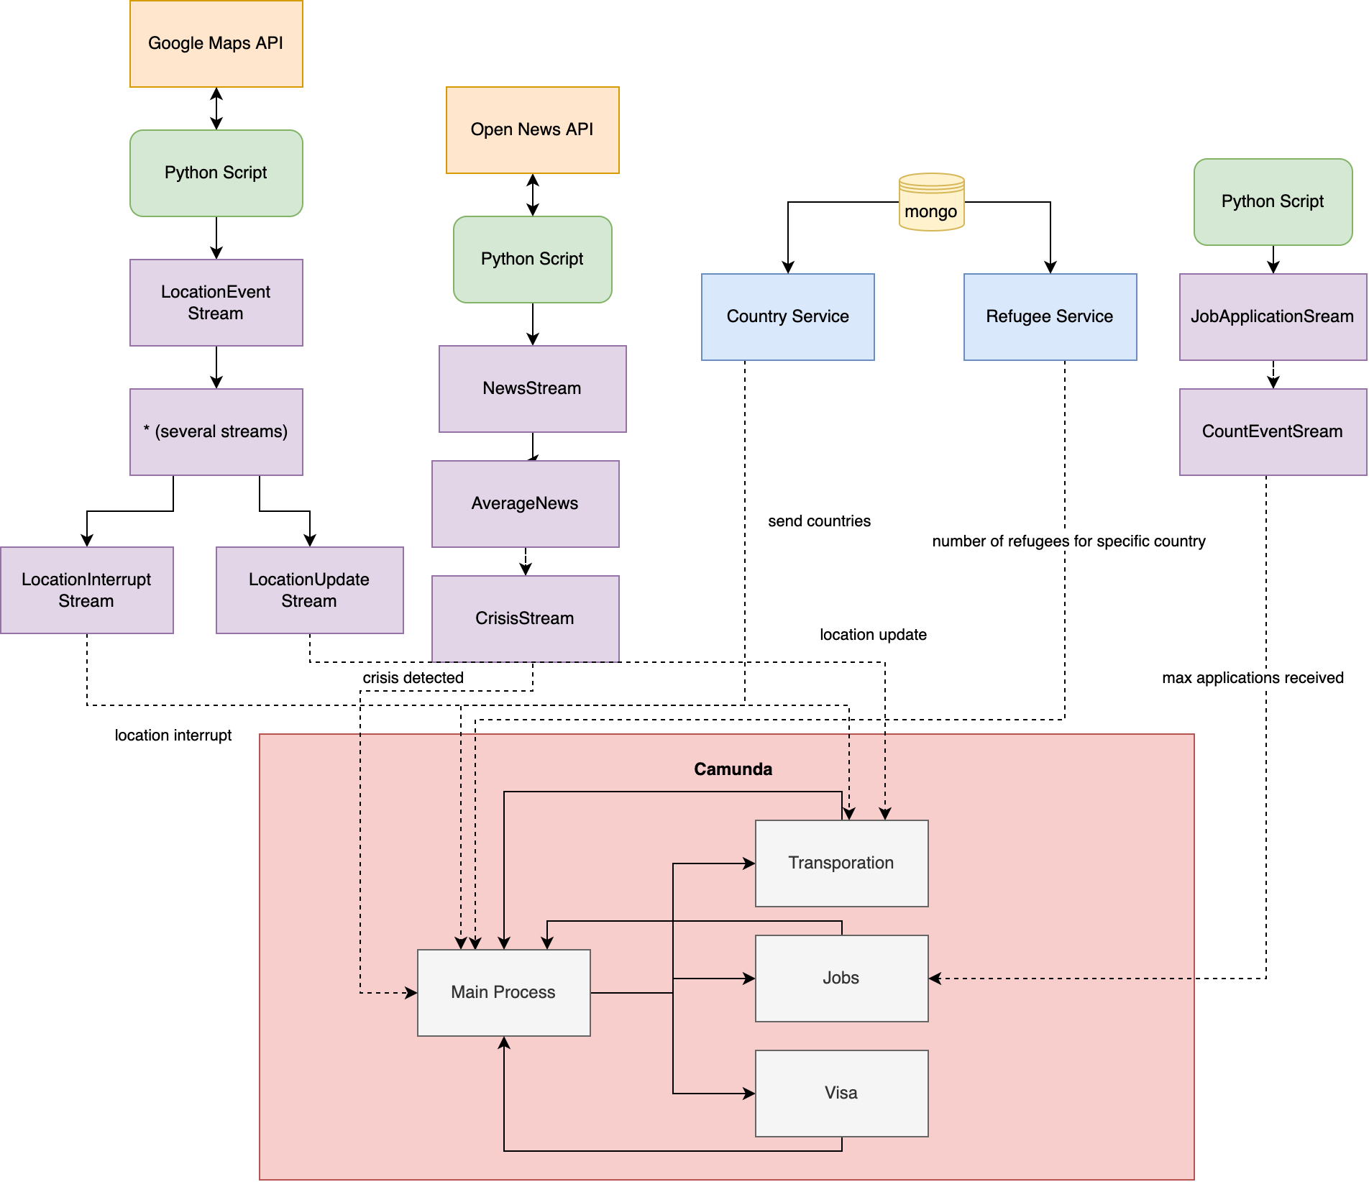
Crisis Response: Ukraine Refugee Support 3. Processes and Events
Architecture

Slide 17

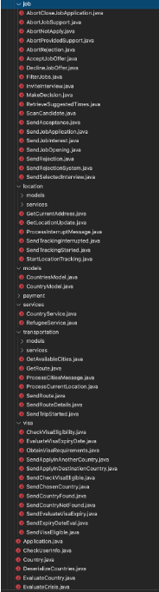
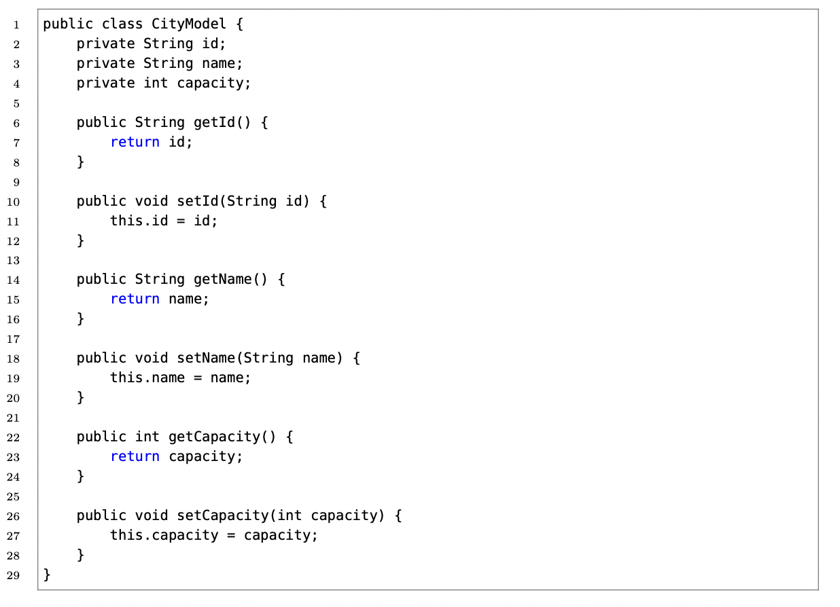
Crisis Response: Ukraine Refugee Support 4. Implementation
Camunda – Wrapped in Spring Project

Slide 18

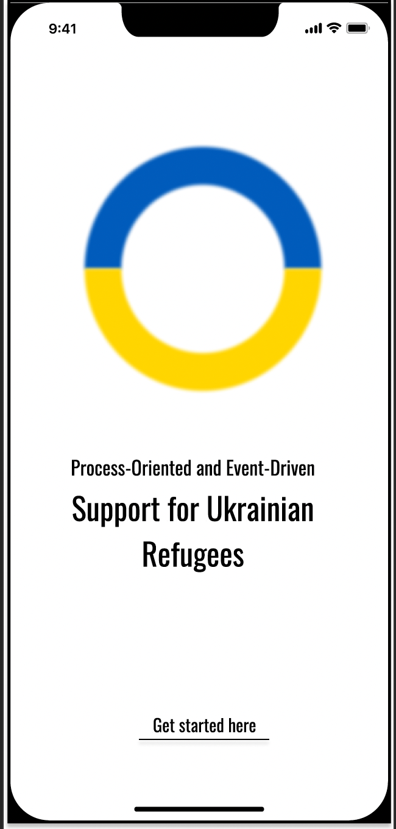
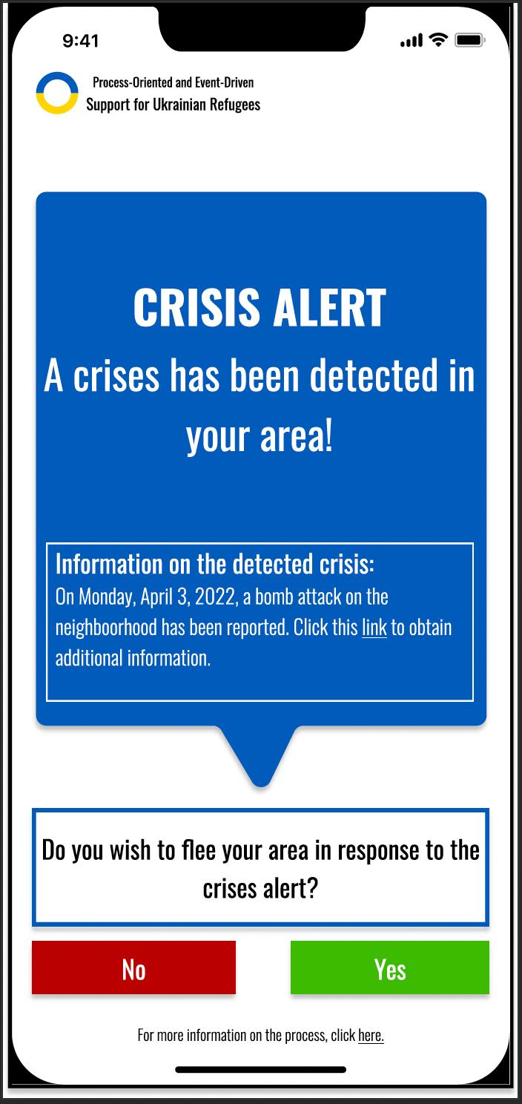
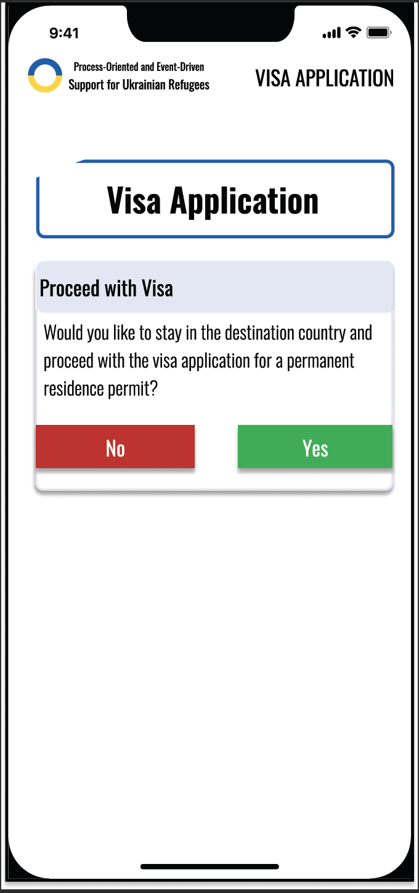
Crisis Response: Ukraine Refugee Support 4. Implications and Limitations
App UI

